Slide 1


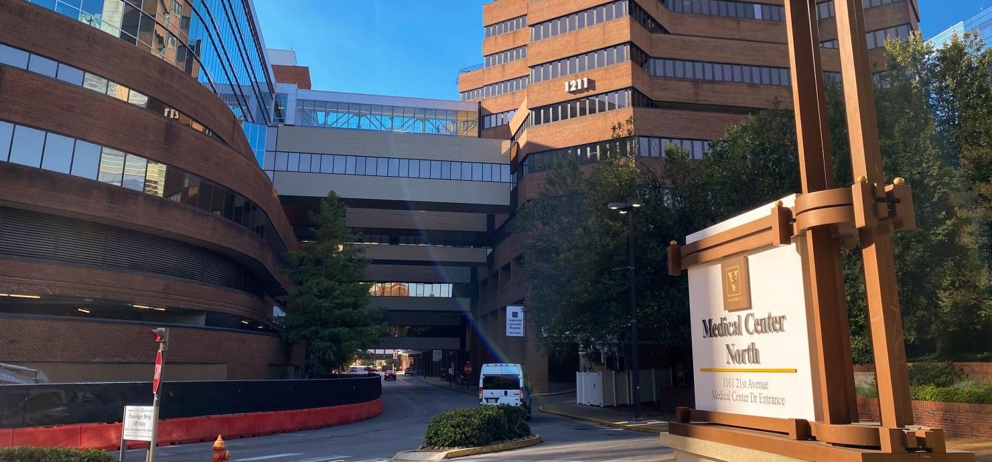
VANDERBILT HEALTH DIRECT-TO-EMPLOYER PLAN
October 29, 2024

Slide 2



Founded in 1979 and headquartered in Indianapolis, IN​
Full-service TPA specializing in the administration of self-funded health plans and population health management​
One of the country’s largest independently-owned TPAs
The Key Family is a commonly-held group of benefits related organizations with:​
3,000+ corporate clients​
3.0 million members under management​
700 Employees
Exclusive Relationships
We know The Market – Agents, Networks, and MGAs

Slide 3


Market Leader in Private Labeled DTE Plans
Louisville, KY
OneHealth Plan
Cincinnati, OH
TCH Optimal
Bentonville, AR
Northwest Health Plan
Knoxville, TN
East Tennessee Health Plan
Meridian, MS
Affinity Health Plan
Fort Myers, FL
Lee Health Care Partners

Slide 4

Direct-to-Employer Strategy: Only Available to Premier Health Systems
STRONG Brand Quality
EXTENSIVE Patient Access
AFFORDABLE Value Pricing
EXCELLENT Care Quality

Slide 5
Vanderbilt Health is Patient Recommended
Health System | HCAHPS Recommendation Percentile | CMS Stars Percentile | Mortality Percentile | Readmission Percentile | KBA Brand Quality Score
Vanderbilt Health | 75 | 83 | 60 | 78 | 70
Ascension Health | 72 | 54 | 67 | 75 | 69
Huntsville Hospital Health System | 64 | 32 | 68 | 73 | 65
Other Independent Hospitals | 55 | 36 | 54 | 52 | 65
Maury Regional Health System | 52 | 61 | 73 | 76 | 64
Williamson Health | 55 | 87 | 69 | 92 | 63
HCA Healthcare | 51 | 64 | 82 | 61 | 62
LifePoint Health | 26 | 28 | 64 | 71 | 51
Community Health Systems | 11 | 30 | 67 | 54 | 48
Based on quality measures and HCAHPS feedback, KBA estimates that Vanderbilt Health has the strongest brand quality Central Tennessee.

Slide 6
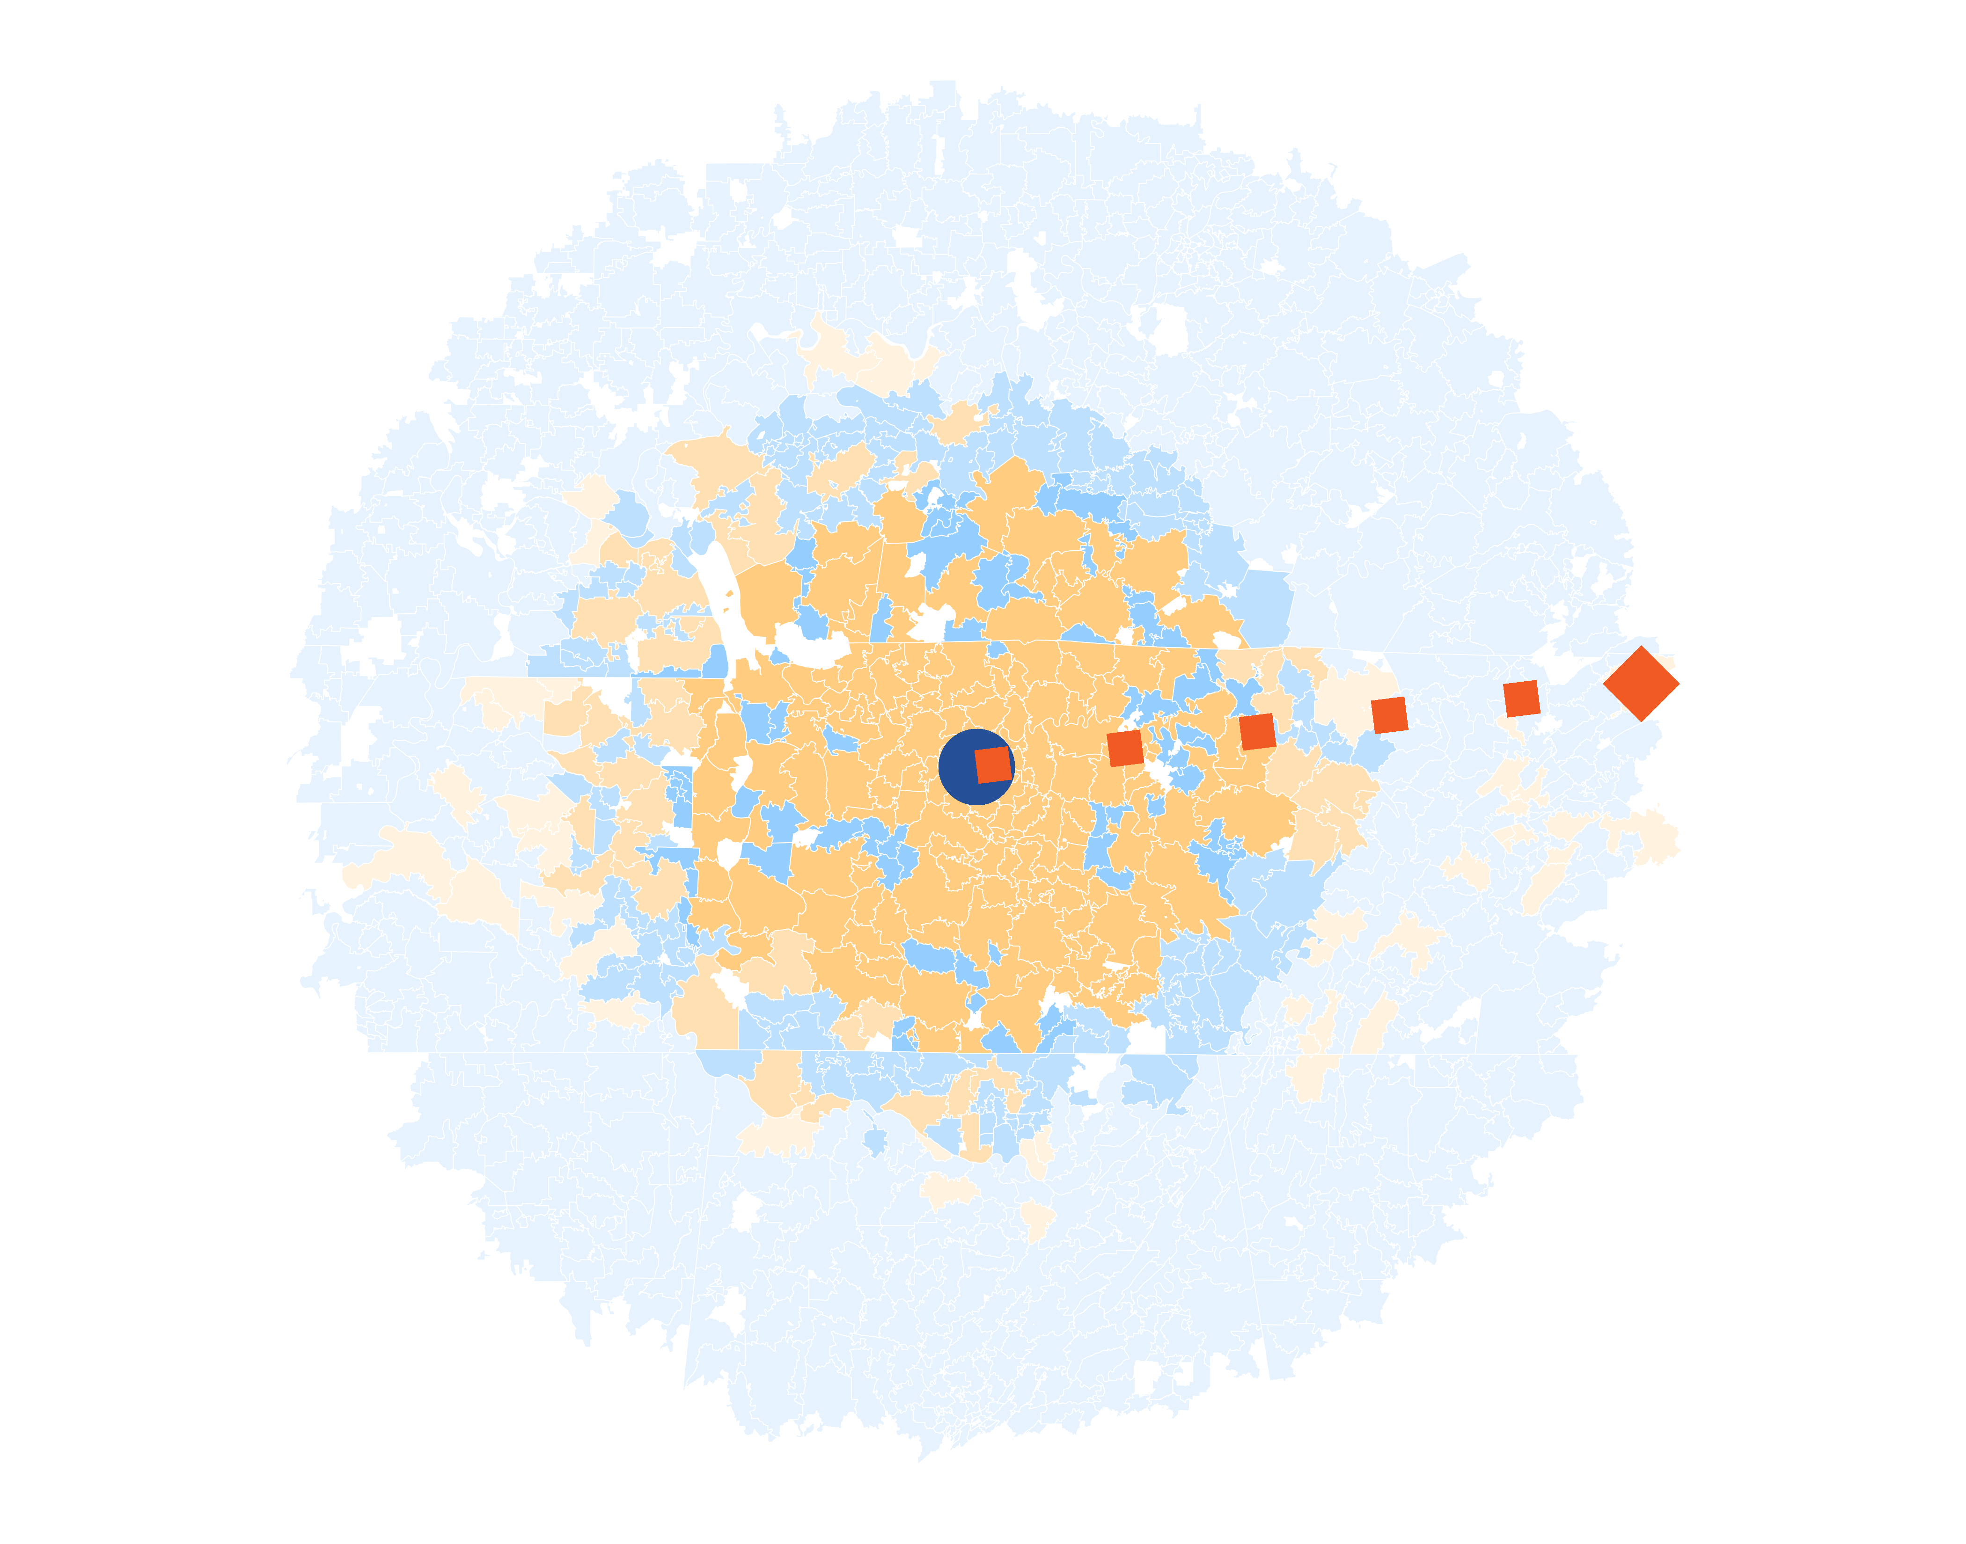
Patients Pass Other Hospitals to Come to Vanderbilt Health
KBA models Medicare patient encounter data to identify strong health system brands where patients will travel past other hospitals or long distances to frequent a specific hospital.
The center of the donut are zip codes within which patients have a higher probability of frequenting . These zip codes are ignored for this analysis.
Significant patient encounters outside of this center, as seen here, indicate that patients are willing to travel significant distances, passing other hospitals to go to .
12 patients (admissions) traveled 298.3 miles to Vanderbilt University Medical Center despite 271 closer hospitals.

Slide 7
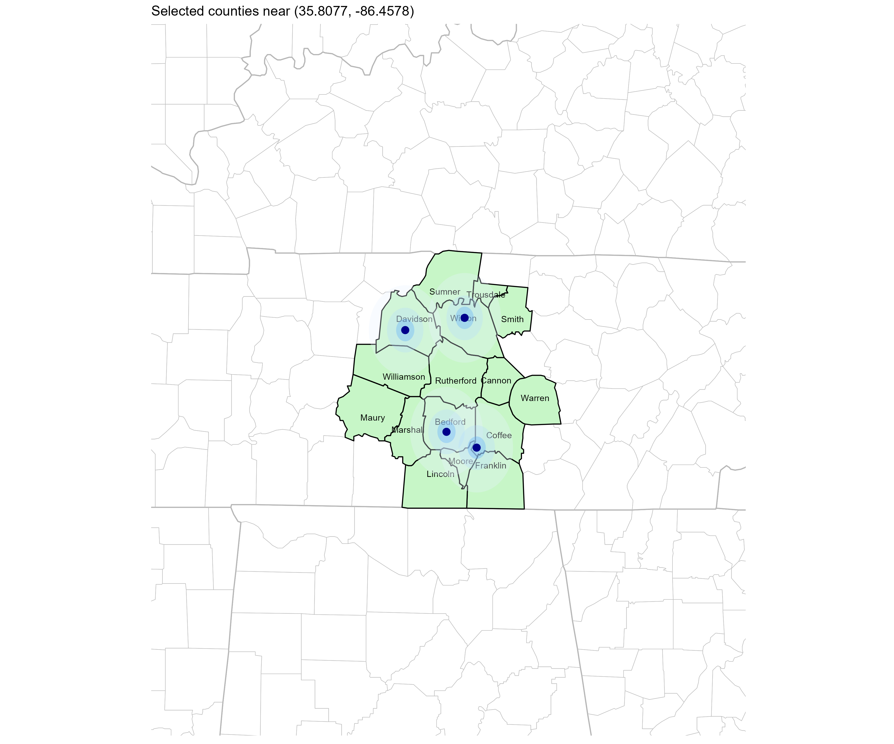
Significant Opportunity for Plan Growth Researched for Central Tennessee
Target Market 900+ Employers 120,000+ Employees 190,000+ Members
 | Employer Size Group (# of Employees)
Commercial Employers With Headquarters | 50-100 | 101-200 | 201-400 | 401-1,000 | 1,001-3,000 | 3,000+
In Catchment Area | 911 | 352 | 192 | 141 | 56 | 29
Total Employees at Employers | 50-100 | 101-200 | 201-400 | 401-1,000 | 1,001-3,000 | 3,000+
Headquartered in Catchment Area | 115,900 | 99,500 | 126,600 | 194,600 | 194,000 | 486,000
Total Members with Employers | 50-100 | 101-200 | 201-400 | 401-1,000 | 1,001-3,000 | 3,000+
Headquartered in Catchment Area | 208,600 | 179,100 | 227,900 | 350,300 | 349,200 | 874,800
Estimates include Sumner, Trousdale, Wilson, Smith, Davidson, Williamson, Rutherford, Cannon, Maury, Marshal, Bedford, Coffee, Moore, Lincoln, Franklin

Slide 8
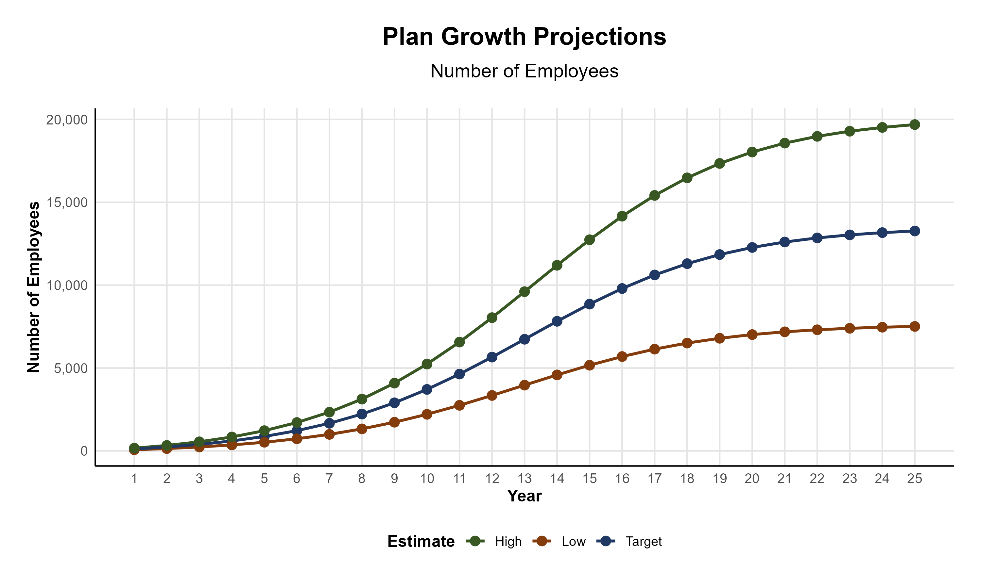
Plan Potential Growth Paths
Self Funded
704K
PLAN GROWTH POTENTIAL
1,335K
Insured
Working Age
1,885K
Population
3,120K
Estimates include Sumner, Trousdale, Wilson, Smith, Davidson, Williamson, Rutherford, Cannon, Maury, Marshal, Bedford, Coffee, Moore, Lincoln, and Franklin Counties

Slide 9

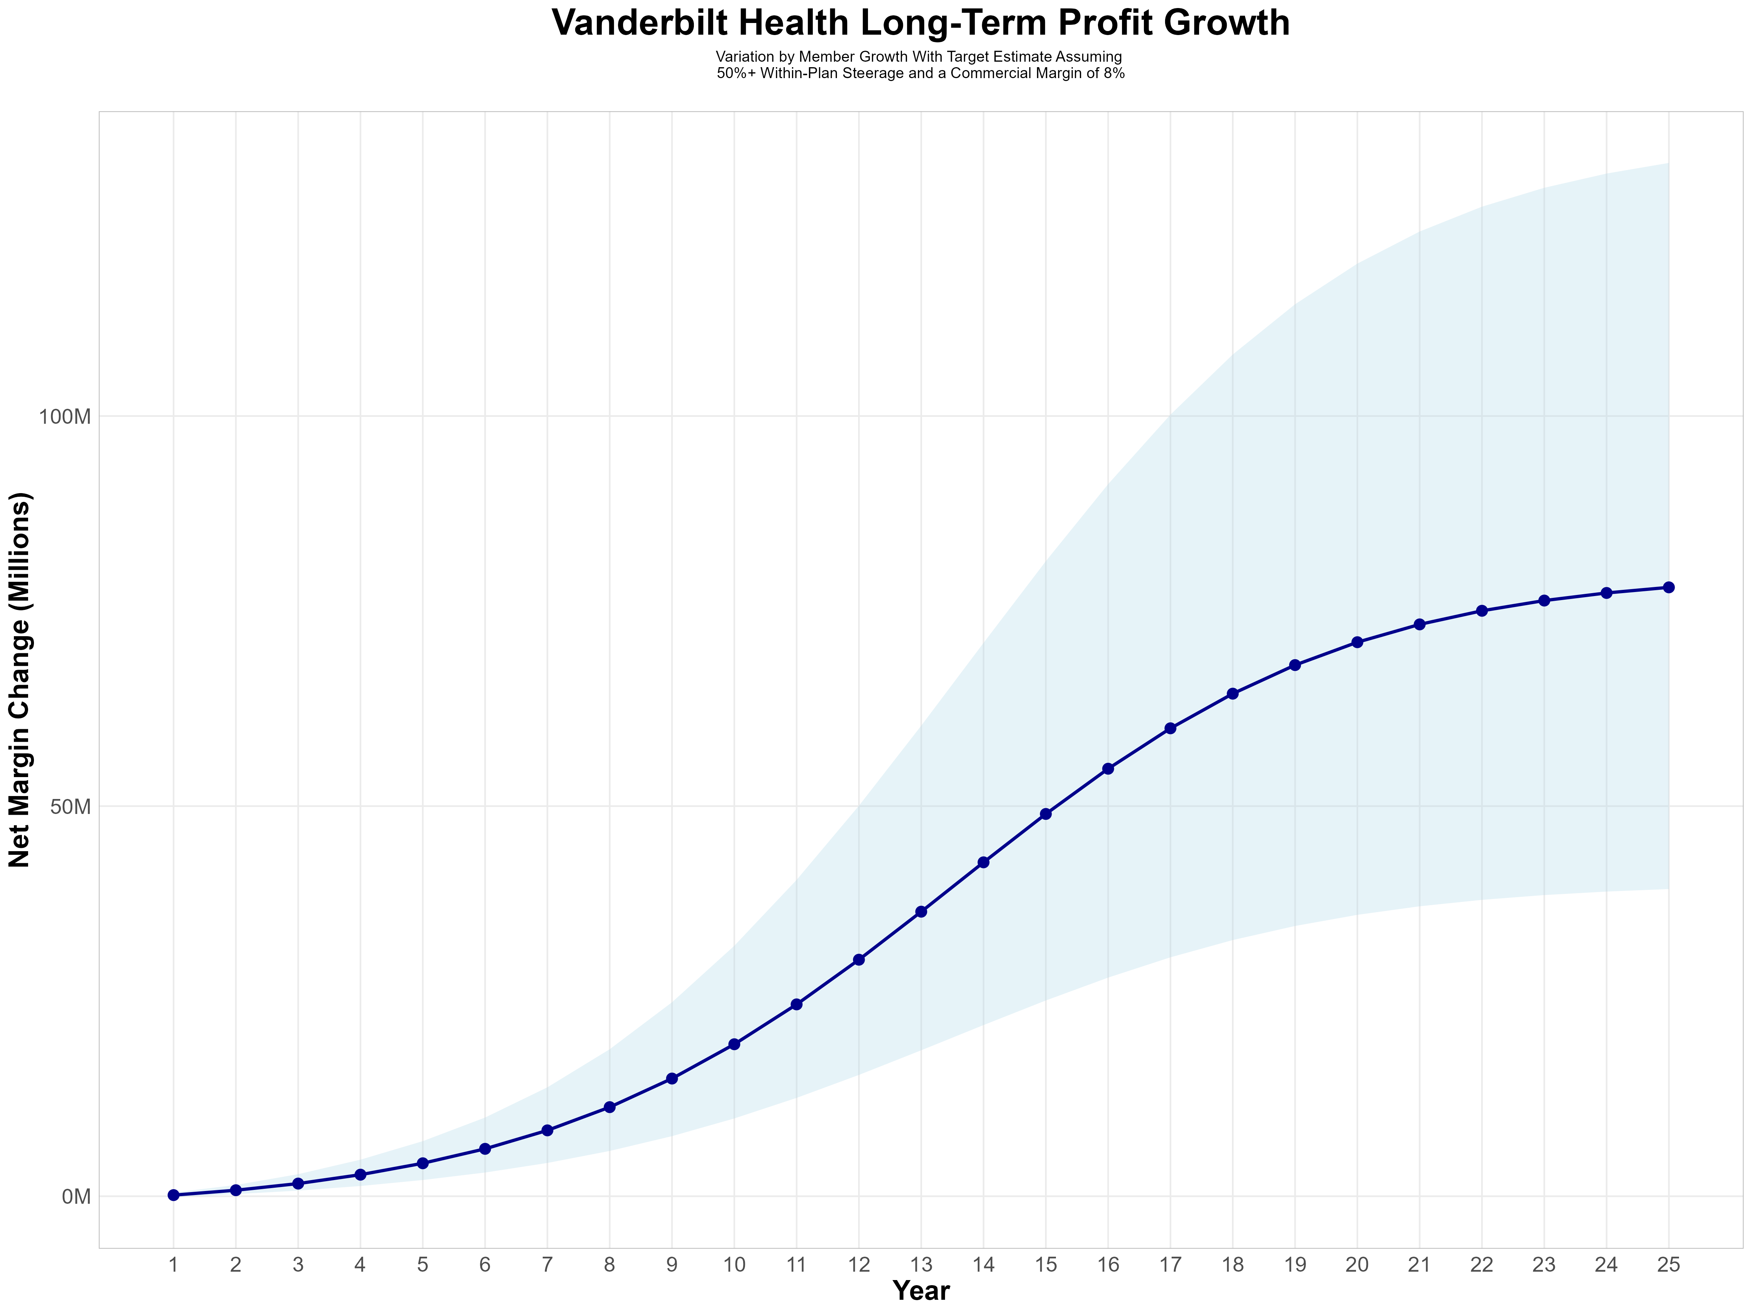
Growing Powerful, Lasting Profitability
Early Stage
Gaining Name Recognition, Early Growth
New Revenue:
New Profit:
$54.62M
$4.43M
Growth Stage
Strong Reputation, Strong Growth
New Revenue:
New Profit:
$405.54M
$34.07M
Mature Stage
High Profitability, Market Saturation
New Revenue:
New Profit:
$851.65M
$71.5M

Slide 10
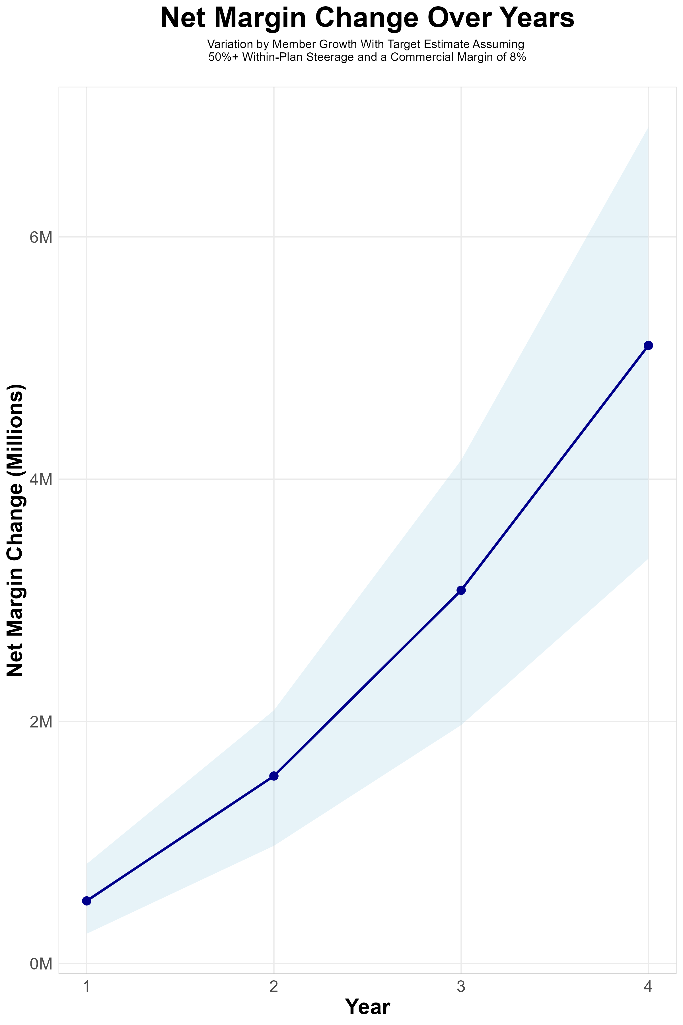
FOUR-YEAR PROJECTIONS
Target Member Growth | Target Member Growth | Target Member Growth | Target Member Growth | Target Member Growth
Metric | Year 1 | Year 2 | Year 3 | Year 4
Number of Members | 2,500 | 5,100 | 8,500 | 12,900
Incremental Margin | 817.5K | 1,667.8K | 3,160.5K | 5,129.5K
Network Access Fee | 30.0K | 61.2K | 102.0K | 154.8K
Implementation Fee (One-Time) | -150.0K | 0.0K | 0.0K | 0.0K
Sales and Marketing Costs | -180.0K | -180.0K | -180.0K | -180.0K
Net Margin Change | 517.5K | 1,549.0K | 3,082.5K | 5,104.3K
High Member Growth | High Member Growth | High Member Growth | High Member Growth | High Member Growth
Metric | Year 1 | Year 2 | Year 3 | Year 4
Number of Members | 3,400 | 6,700 | 11,300 | 17,300
Incremental Margin | 1,111.9K | 2,191.0K | 4,201.5K | 6,879.1K
Network Access Fee | 40.8K | 80.4K | 135.6K | 207.6K
Implementation Fee (One-Time) | -150.0K | 0.0K | 0.0K | 0.0K
Sales and Marketing Costs | -180.0K | -180.0K | -180.0K | -180.0K
Net Margin Change | 822.7K | 2,091.4K | 4,157.1K | 6,906.7K
Low Member Growth | Low Member Growth | Low Member Growth | Low Member Growth | Low Member Growth
Metric | Year 1 | Year 2 | Year 3 | Year 4
Number of Members | 1,700 | 3,400 | 5,600 | 8,600
Incremental Margin | 555.9K | 1,111.9K | 2,082.2K | 3,419.7K
Network Access Fee | 20.4K | 40.8K | 67.2K | 103.2K
Implementation Fee (One-Time) | -150.0K | 0.0K | 0.0K | 0.0K
Sales and Marketing Costs | -180.0K | -180.0K | -180.0K | -180.0K
Net Margin Change | 246.3K | 972.7K | 1,969.4K | 3,342.9K

Slide 11
SINGLE YEAR SUMMARY
DTE Covered Members Financial Analysis | DTE Covered Members Financial Analysis | DTE Covered Members Financial Analysis | DTE Covered Members Financial Analysis | DTE Covered Members Financial Analysis | DTE Covered Members Financial Analysis | DTE Covered Members Financial Analysis | DTE Covered Members Financial Analysis
Target Estimate Assuming 50%+ Within-Plan Steerage and a Commercial Margin of 8%. | Target Estimate Assuming 50%+ Within-Plan Steerage and a Commercial Margin of 8%. | Target Estimate Assuming 50%+ Within-Plan Steerage and a Commercial Margin of 8%. | Target Estimate Assuming 50%+ Within-Plan Steerage and a Commercial Margin of 8%. | Target Estimate Assuming 50%+ Within-Plan Steerage and a Commercial Margin of 8%. | Target Estimate Assuming 50%+ Within-Plan Steerage and a Commercial Margin of 8%. | Target Estimate Assuming 50%+ Within-Plan Steerage and a Commercial Margin of 8%. | Target Estimate Assuming 50%+ Within-Plan Steerage and a Commercial Margin of 8%.
DTE Members | Pre-DTE Revenue | Pre-DTE Margin | DTE Revenue | DTE Incr. Revenue | DTE Total Margin | DTE Incr. Margin | Net Margin Less DTE Fees
100 | $ 224K | $ 18K | $ 618K | $ 394K | $ 49K | $ 32K | $ -297K
500 | $ 1,122K | $ 90K | $ 3,091K | $ 1,969K | $ 247K | $ 158K | $ -166K
1,000 | $ 2,244K | $ 180K | $ 6,182K | $ 3,938K | $ 495K | $ 315K | $ -3K
2,500 | $ 5,611K | $ 449K | $ 15,455K | $ 9,844K | $1,236K | $ 788K | $ 488K
10,000 | $22,444K | $1,796K | $ 61,822K | $39,377K | $4,946K | $3,150K | $2,940K
20,000 | $44,888K | $3,591K | $123,643K | $78,755K | $9,891K | $6,300K | $6,210K
NOTE: Please see detailed financial analysis and assumptions in extended financial forecast.
Financial projections do not include 340B contribution margin, which could represent $136 PMPM by optimizing 340B through Rx plan design, Vanderbilt Health’s approved site(s) with network integration, and development of Vanderbilt Health’s proprietary PBM program.

Slide 12
Year 4 Projected Revenue and Profit
Pre-DTE Cohort of 12,900 Employees | Inpatient | Outpatient | Professional | Total
Revenue† | $ 10,690,296 | $ 12,449,120 | $ 5,813,633 | $ 28,953,049
Net Income‡ | $ 855,223.6 | $ 995,929.6 | $ 465,090.7 | $ 2,316,244
† Assuming proportional revenues from market shares of 26% (inpatient) and 17% (outpatient)
‡ Conservatively assuming a commercial margin of 8% (80% of the estimated commercial margin)
With DTE | Inpatient | Outpatient | Professional | Total
Revenue⁰ | $ 27,628,406 | $ 43,291,906 | $ 20,216,952 | $ 91,137,264
Net Income* | $ 2,210,273 | $ 3,463,352 | $ 1,617,356 | $ 7,290,981
⁰ Assuming 67% inpatient and 58% market steerage based on KBA narrow network DTE experience
* Conservatively assuming a commercial margin of 8%, with a 10 percentage-point reduction to reflect competitive-edge rates and a 10 percentage-point increase due to lower billing costs and higher patient responsibility collections because of the member credit card.
Total Increase in Net Income | $ 4,974,737
Network Access Fee (Revenue) of $1 PMPM | $ 154,800
Total Profit Growth | $ 4,979,537
Minus Implementation Fee (Year-1 Only) | -$ 0
Minus Sales and Marketing (Annual – Ongoing) | -$ 180,000
Total | $ 4,949,537

Slide 13

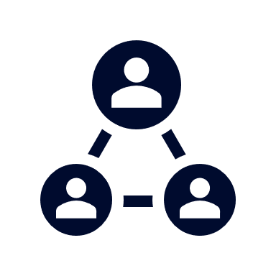



A Partner You Can Trust
OUR OBJECTIVES ARE ALIGNED
WE KNOW THE
MARKET
COMPLETELY TRANSPARENT
WE HAVE THE SOPHISTICATION AND INFRASTRUCTURE TO EFFECTIVELY COMPETE
Derek Moore, Senior Vice President – KBA
845-283-9973 * derek.moore@keybenefit.com

